Slide 1



What are the HRS4R benefits/impact for institutions and researchers?
Better Research Talent Management
for a better Bugaria and Romania
REGIONAL WORKSHOP – Sofia (BG)
Representation of the European Commission in Bulgaria
17 October 2017
Isabelle Halleux, Dr. Ir.
University of Liège (BE)
All my presentations are published on http//orbi.ulg.ac.be, the ULiège Open Repository

Slide 2



2006
ULiège signed for being on board
Each institution has to draw
its own boat and to embed the
Euraxess initiatives in its
Institutional Strategic Plan
In 2006,
ULiège began by committing with the C&C principles, creating an Euraxess
Mobility Centre and implementing some few HR actions
Sofia, BG, 17/10/2017

Slide 3
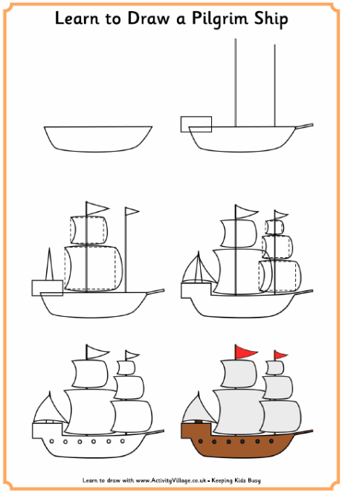

2010/11
Gap analysis
Action plan
Award
We adapted our structure to the needs for a more effective implementation of the Charter and Code. ULiège was the first Belgian University awarded
for its HRS4R
Sofia, BG, 17/10/2017

Slide 4

The boat navigated on calm and furious seas. Results were mostly collected from existing actions. Transversal training for young researchers and supervisors was
developed.
2013/14
Sofia, BG, 17/10/2017

Slide 5

Advices from safeguards
Work on HRS4R as a project :
  Get a strong commitment
  Devote competences and time
  Use or develop drivers for action
  Accept risks and uncertainty
  Track and record progress
  Communicate, disseminate
Be open, proactive, patient, resilient and brave !
Find and use drivers for action
Sofia, BG, 17/10/2017

Slide 6

Drivers for action?
Involve colleagues & board
Communicate with governmental bodies
Benefit from your networks
Participate in international projects
Engage and disseminate
Sofia, BG, 17/10/2017

Slide 7

2015/16
The boat was ready to sail the oceans, with a lot of people on board with visibility, efficiency, transparency …
Sofia, BG, 17/10/2017

Slide 8
Benefits for the institution
Meet researchers’ needs
Supportive network of colleagues
Support to internal coherence
Contribution to strategic goals
Impetus for change
Transparency, visibility
International attractivity
and competitiveness
Sofia, BG, 17/10/2017

Slide 9
Benefits for the researchers
Being onboard, recognition
Working conditions
Training offer for personal efficiency
Impetus for institutional engagement and partnership
Network with peers
Sofia, BG, 17/10/2017
Notes:
- Recognition of the researchers as professionals, but as important stakeholders and partners in the project
Better working conditions (from the recruitment to the daily life as employees)
Improvement of their personal efficiency, through training, because the development of their career is essential
Impetus for institutional engagement is also fundamental, at all level. The researchers becomes partner in the governance of the institution
Network with the peers involved in the process

Slide 10
Benefits for the society
Contribution to societal needs
Recognition of the profession
Matching of competences with the non academic world
Sofia, BG, 17/10/2017
Notes:
The HRS4R aims to have a direct impact on the researchers and the society. Wherever the researchers are working (in the academic or non academic world), the society has to benefit from their work.
By opening the job market and by developing better working conditions and competences, the HRS4R impacts directly the society and contributes to the ERA.

Slide 11
2017/2020
ULiege award is now to be renewed. Our ambition:
A new HR-action plan
  OTM-R (art. 32)
  Gender and diversity (art. 33)
  Ethics, integrity (art. 34, 35)
  Open Science
More colleagues on board
More researchers involved
Implementation at all levels (PI, faculties)
Sofia, BG, 17/10/2017

Slide 12

A cruise ship, a passenger ship used for pleasure, where the HR itself and the ULiège's amenities are the best part of the experience …
Sofia, BG, 17/10/2017

Slide 13

Up2you now
Make your own boat
- направете своя собствена лодка
-
Fă-ți propria barcă
Sofia, BG, 17/10/2017

